Slide 1

Advanced Database Management (CPSC 531) – Group Project
USA Housing Price Analysis

Slide 2
Team Members
Pallavi Thorat
Ramyasree Karanam
Ishan Tharwal

Slide 3
Dataset
We are using USA Housing Price Dataset, a dataset containing information about housing prices in the United States
Size: 2.0 GB
Dataset consist of price, sq. feet, beds, baths, pets allowed, etc
We got this dataset from kaggle

Slide 4
Technologies and Tools
Databricks
Apache Spark – PySpark
PySpark - RDD
AWS cluster Platform (EMR)
Amazon S3

Slide 5
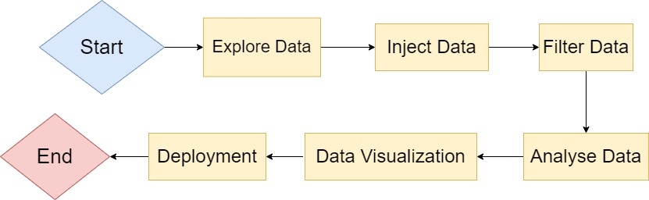
Flowchart

Slide 6
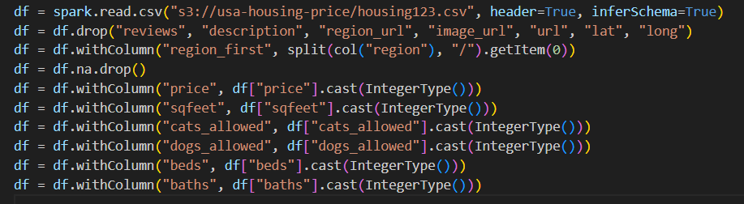
Reading Dataset and Data Filtering

Slide 7
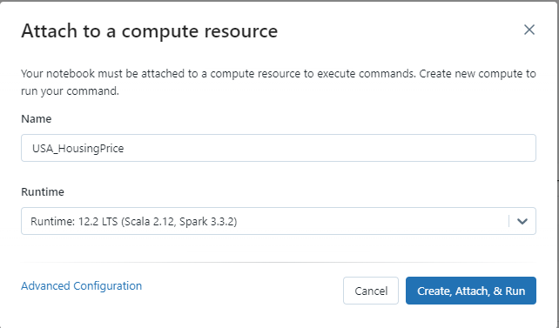
Code Testing on DataBricks
Cluster on Databricks

Slide 8
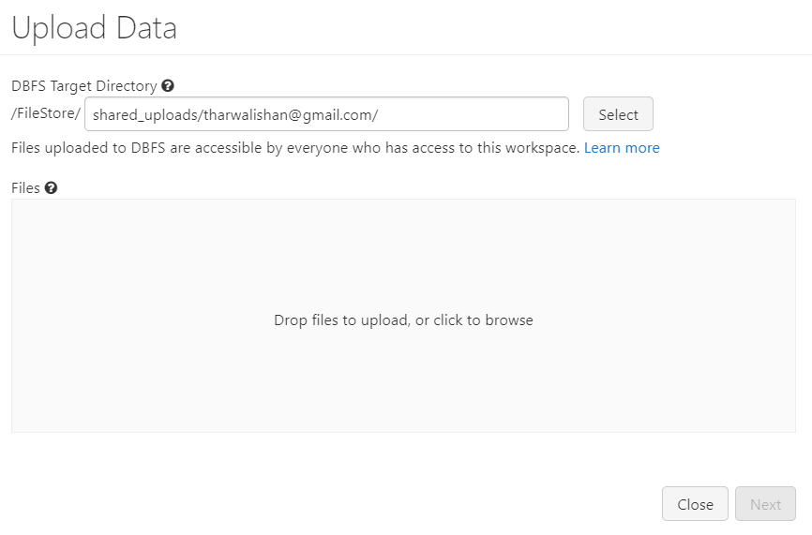
Upload data on DataBricks

Slide 9
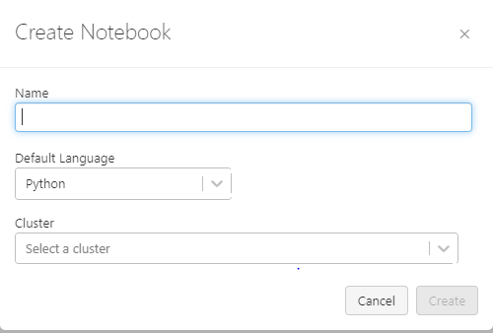
Creating PySpark App on Databricks

Slide 10
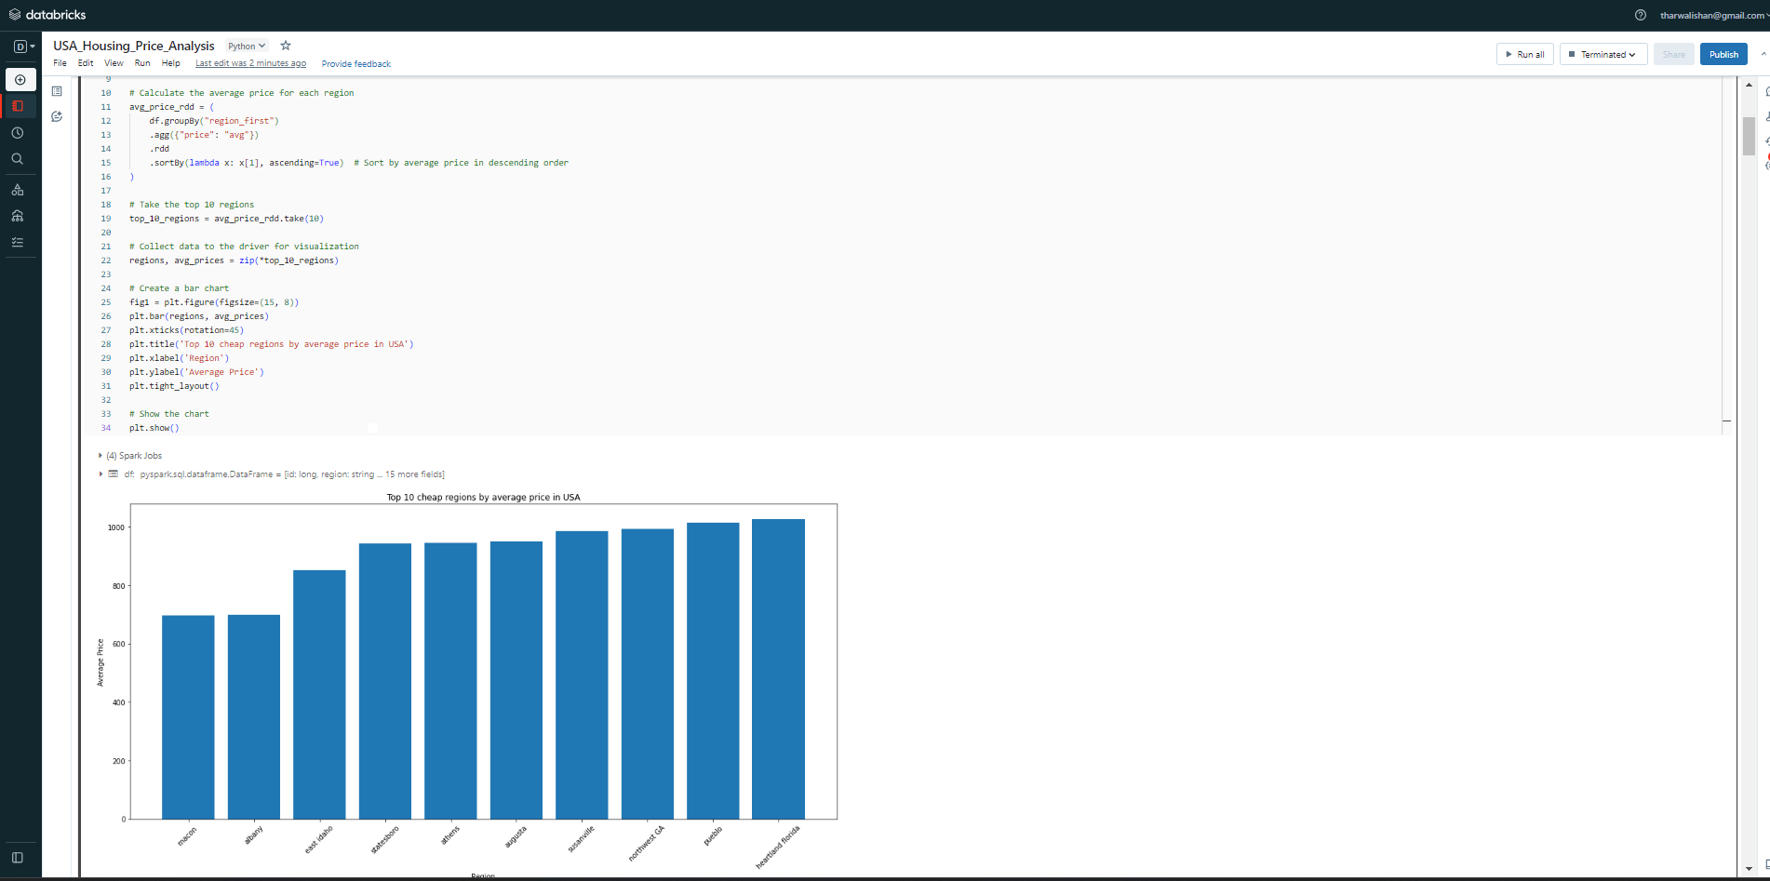
Running PySpark on Databricks

Slide 11

Deploying on AWS

Slide 12
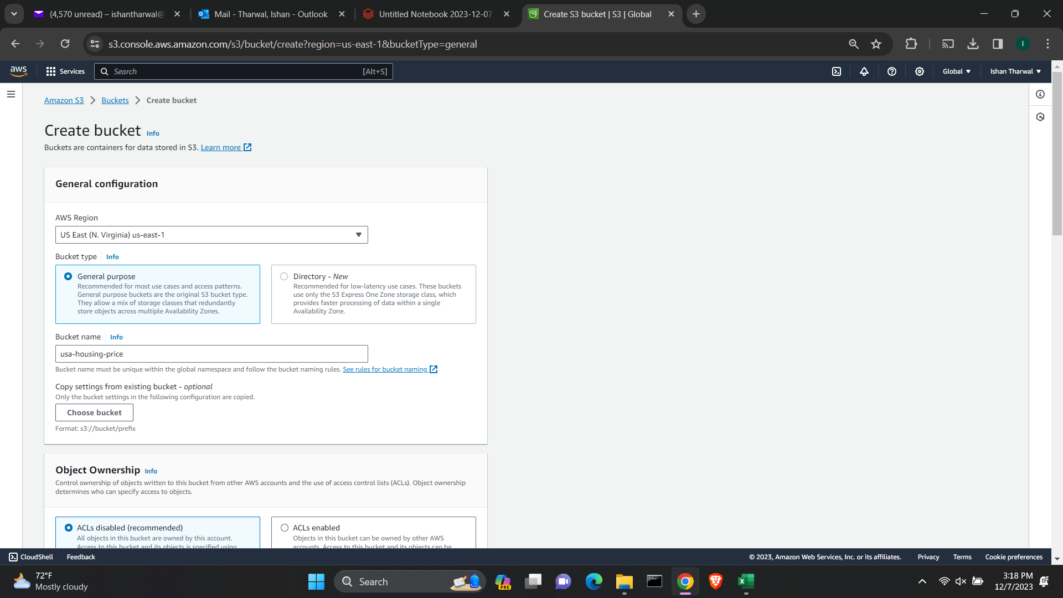
S3 (Simple Storage Service)

Slide 13
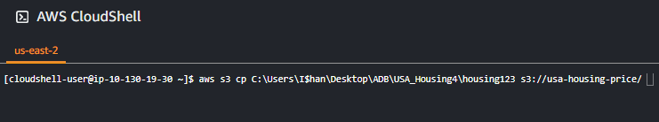
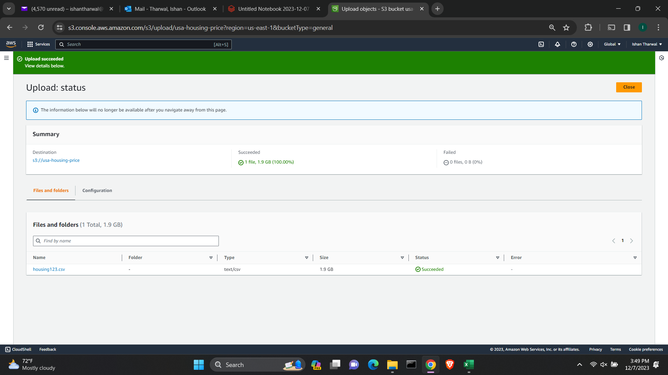
S3 (Simple Storage Service) – Uploading Dataset using AWS CLI

Slide 14
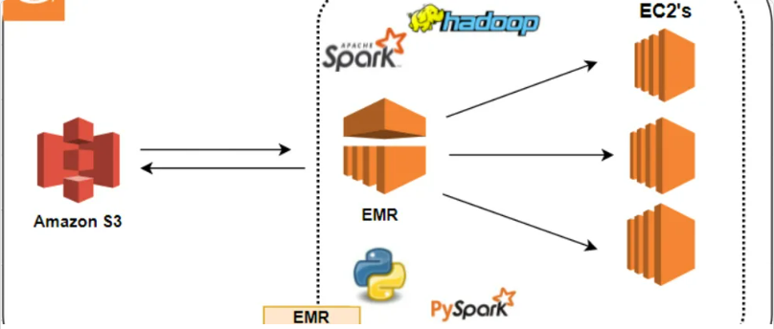
EMR (Elastic MapReduce)

Slide 15
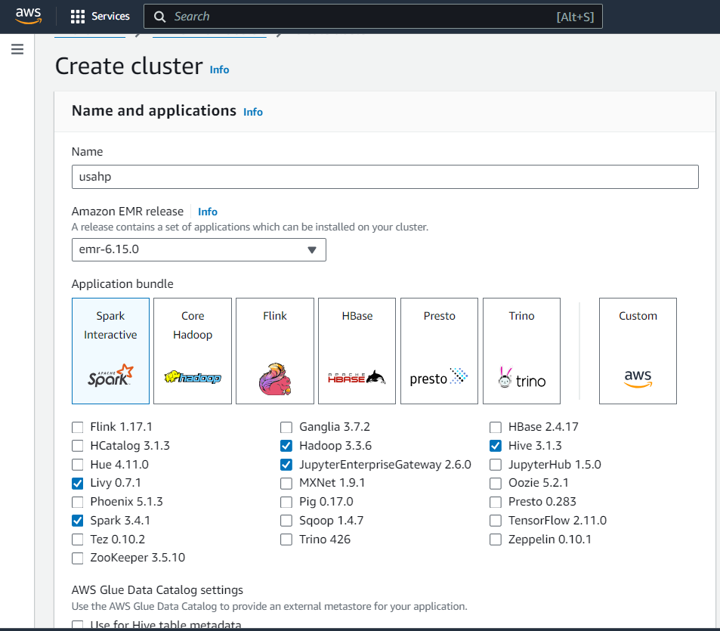
Setting up EMR

Slide 16
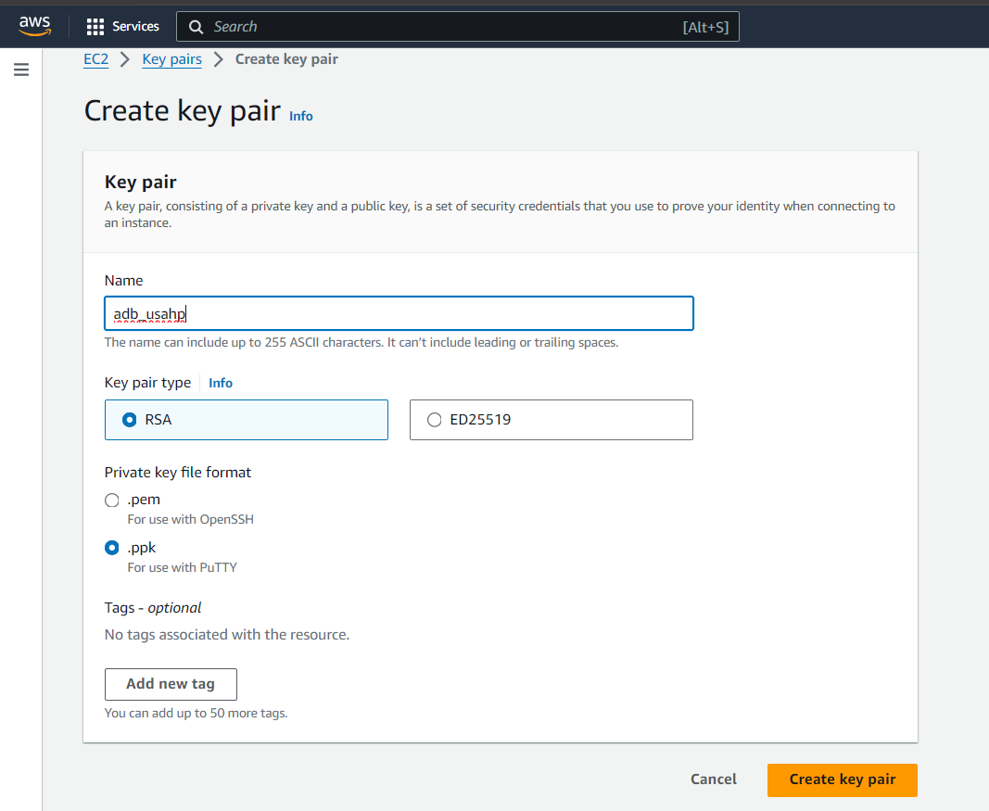
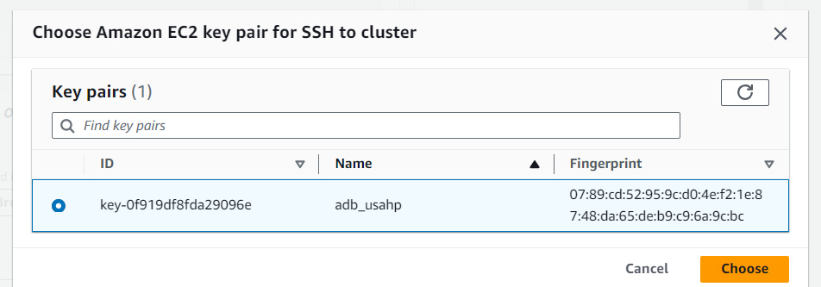
Setting Key-Pair

Slide 17
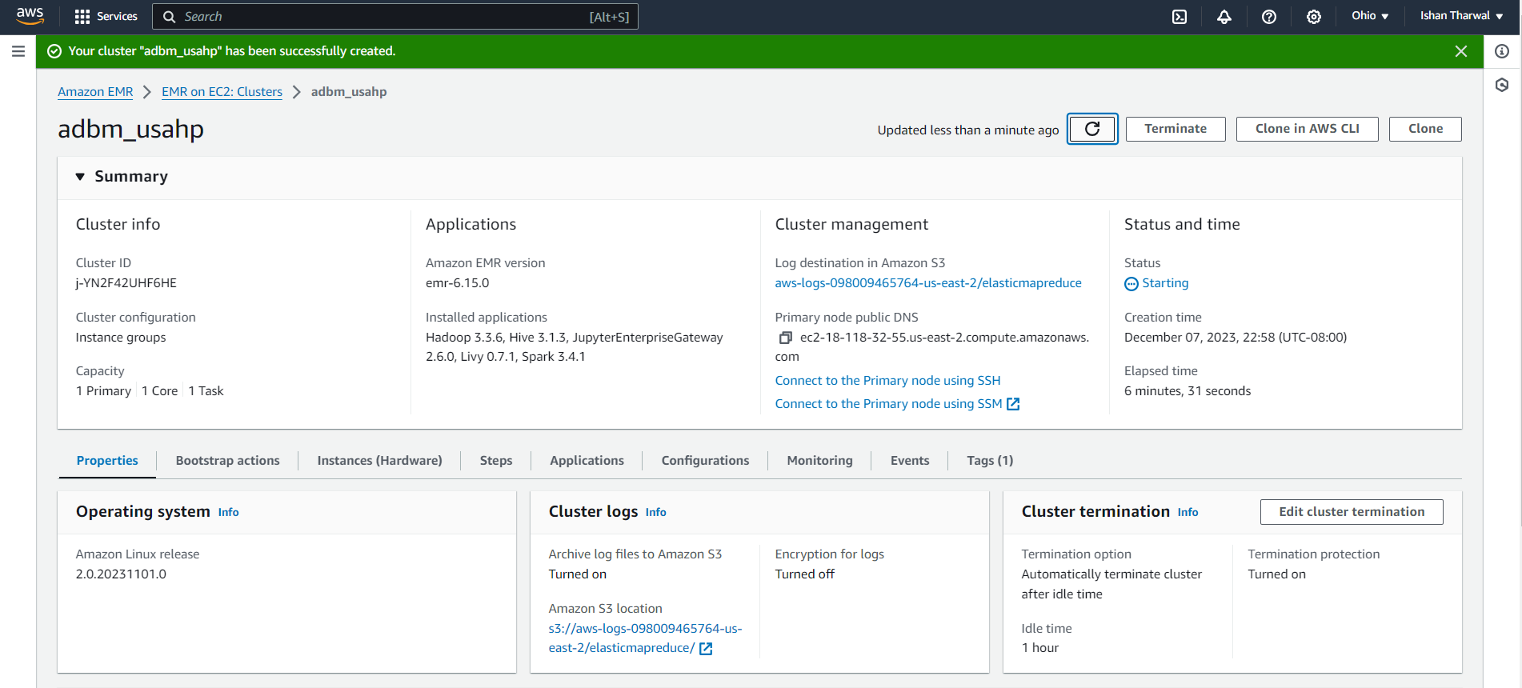
Cluster Created

Slide 18
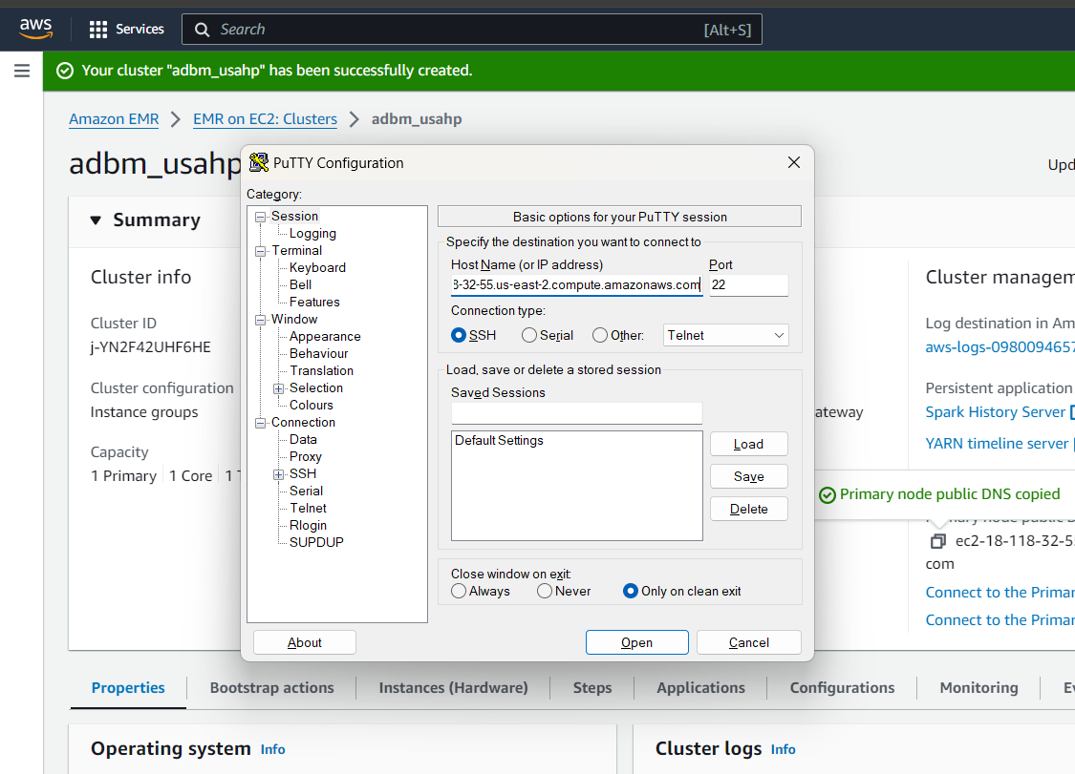
EMR Terminal with PuTTY and Authentication

Slide 19
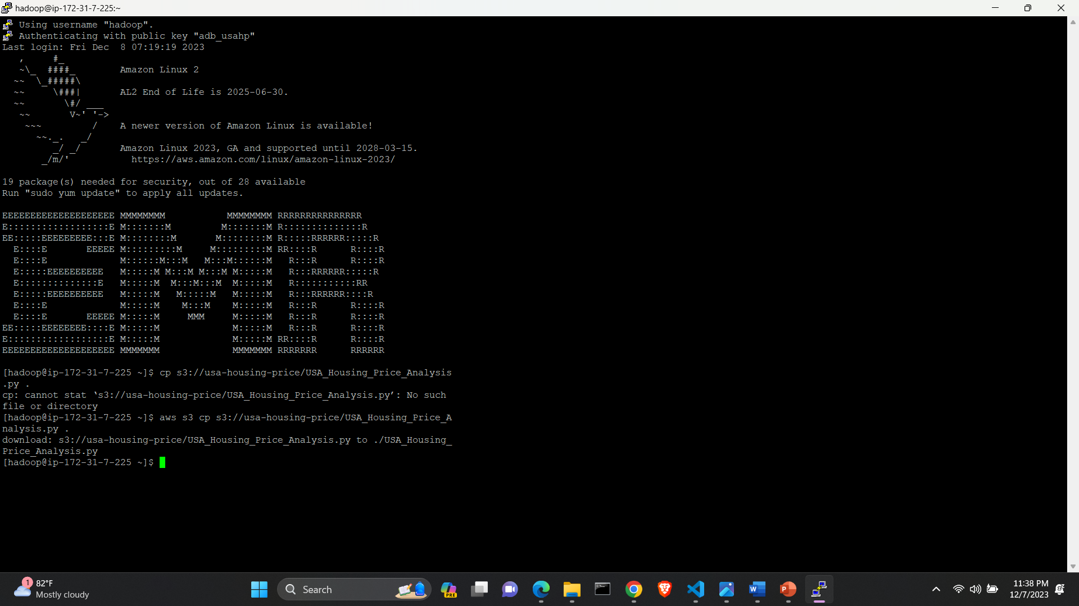
EMR Terminal

Slide 20
Running Pyspark app on EMR
Copy your PySpark file from S3 to EMR
Install necessary packages
Finally spark-submit

Slide 21

Code changes in Pyspark app

Slide 22
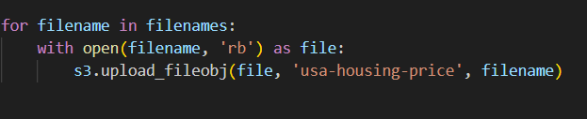
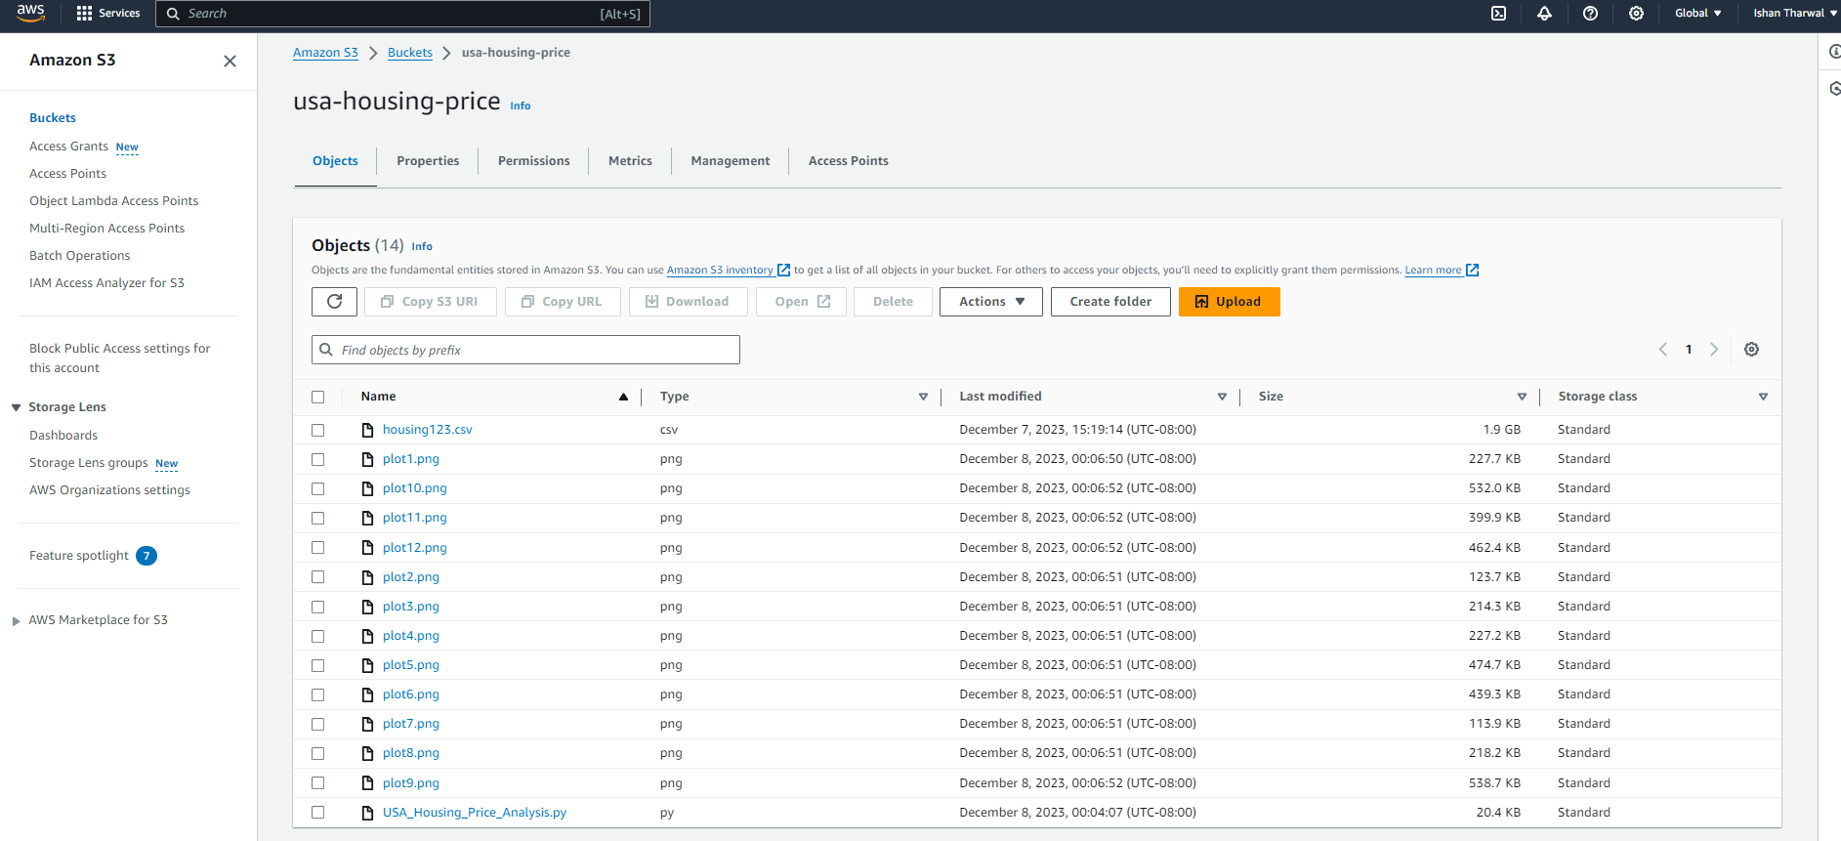
Saving Output to S3

Slide 23
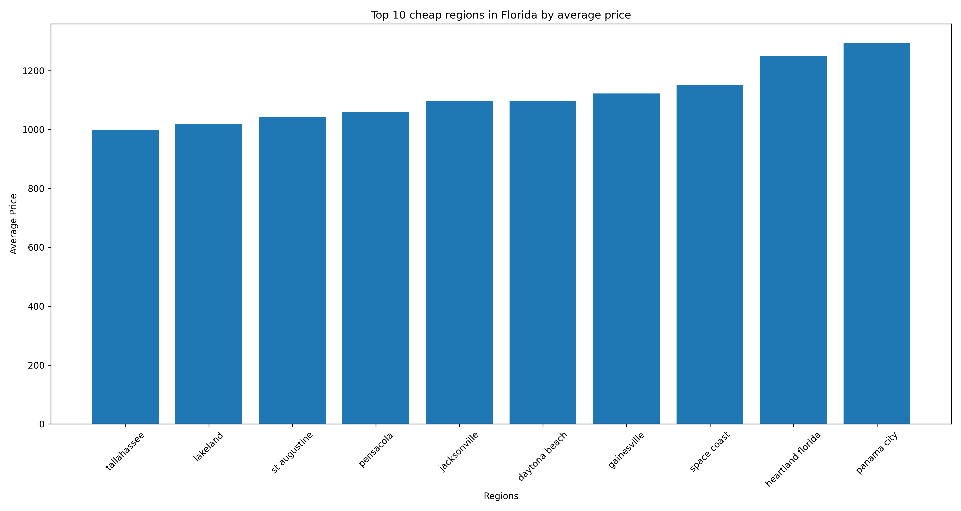
Top 10 cheap regions in Florida by average price

Slide 24
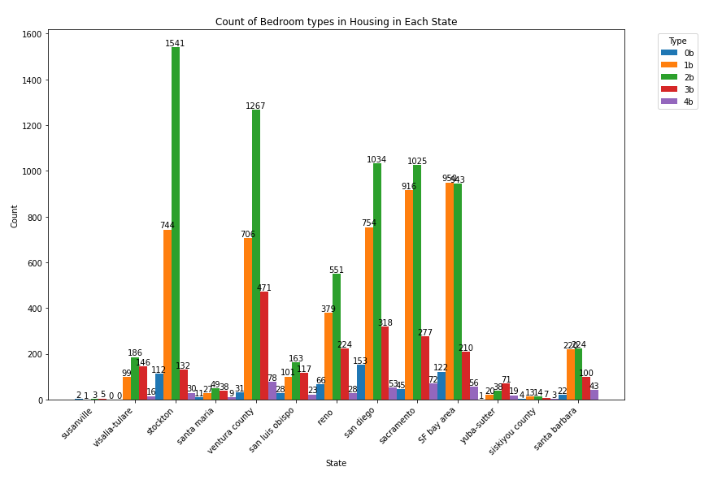
Count of Bedroom types in each regions of California

Slide 25
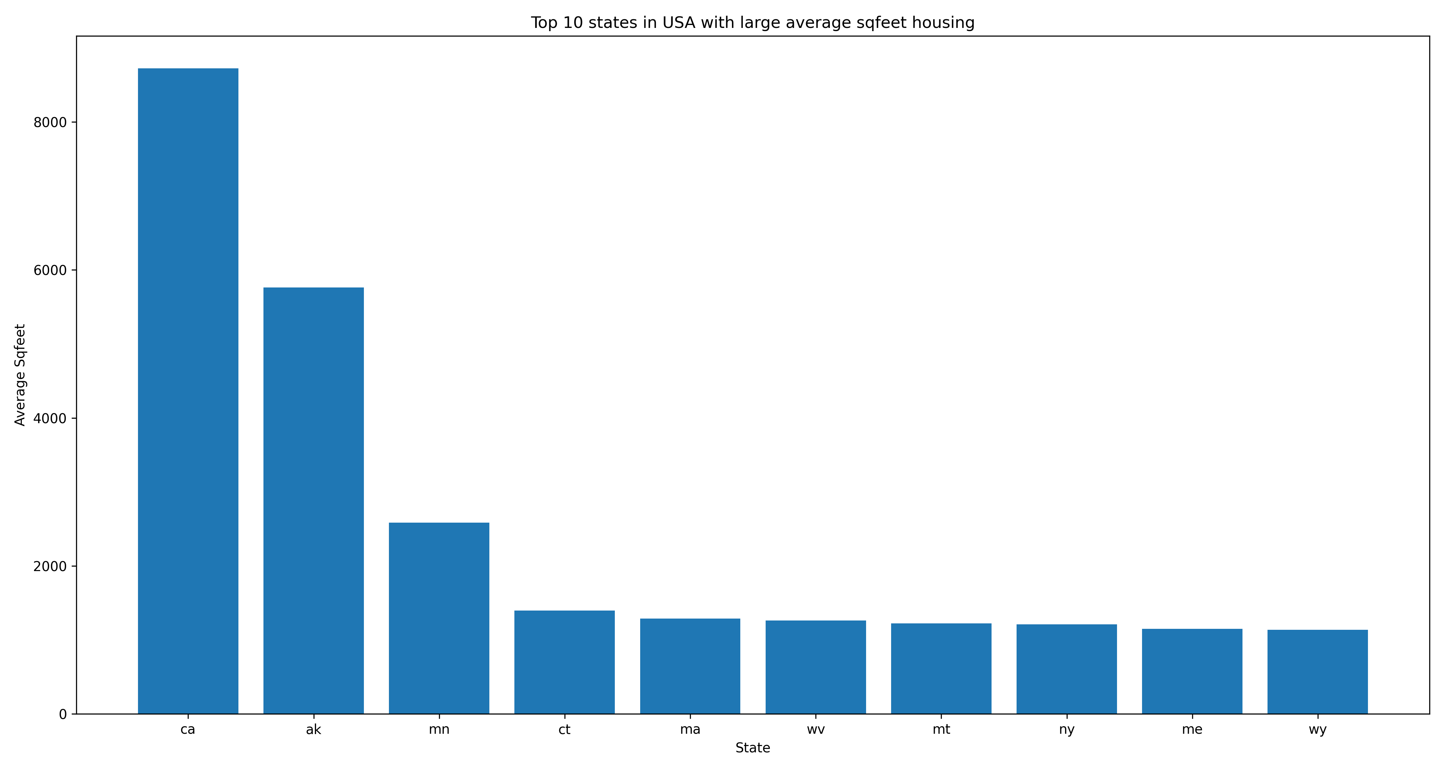
Top 10 states in USA with large average sq. feet housing

Slide 26
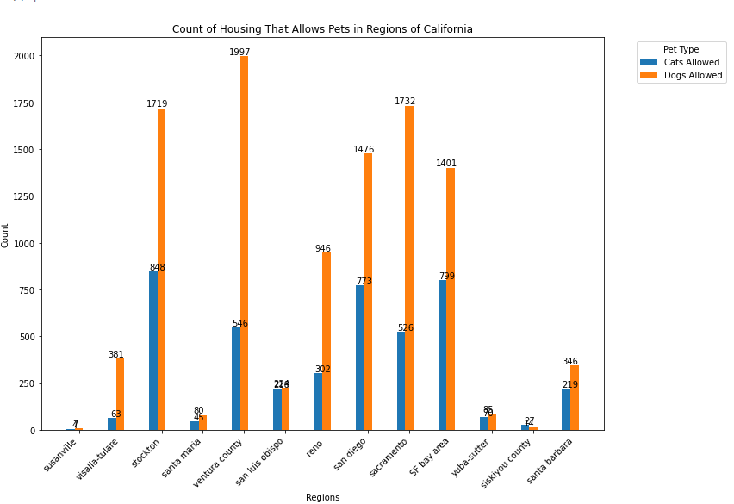
Count of Housing that allows pets in regions of California

Slide 27
Thank You

